Slide 1

DEPARTMENT OF COMPUTER SCIENCE AND ENGINEERING
ADVANCED CCTV ANALYTIC SOLUTION
BATCH NO : 06
ACADEMIC YEAR : 2020-2024
SUPERVISOR : Dr.M.PRABU,B.E.,M.E.,Ph.D.,
K.N MEERAN NASIF - 110120104021
M.H.MOGDOOM KHAN SAHIB -110120104022
A.MOHAMED BASITH ALI - 110120104024
K.M.D.MOHAMMED RIYASATH - 110120104038

Slide 2
ABSTRACT
In response to the imperative need for public safety, we have a CCTV footage in real-time, specifically focusing on the identification of abnormal activities.
Traditional crime detection methods often suffer from delayed responses, prompting the need for a more proactive approach.
Our innovative solution incorporates real-time face recognition, enabling immediate alert notifications to authorities via emails.
Outcomes encompass reduced response times, preventive measures through real-time identification

Slide 3
INTRODUCTION
Remote video surveillance system is simply a way to observe and monitor an area using video camera.
The camera’s purpose is to deter improper behavior, and the video footage can also serve as evidence for later review by security staff or law enforcement.
The main objective of this project is to provide crime detection and proactive alerts.
Provides an alert by sending the crime data instantly to the police or protective service, and thus, it ensures a quick response.
Reduce the time taken and give error free messages

Slide 4
LITERATURE SURVEY
AUTHOR | JOURNAL/CONFERENCE
Brain lee, Nadiya kanwal, Yuansong Qiao | IEEE-Real Time Event Driven Road Traffic Monitoring System Using CCTV Video Analytics
The survey is used to monitor and analyze CCTV video feeds for various contexts like security surveillance, crowd monitoring, and event detection
AUTHOR | JOURNAL/CONFERENCE
Khan Muhammed, Pankaj Kumar Sa, Sambit Bakshi | IEEE-Large Scale Person Re-Identification for Crowd Monitoring in Emergency
The survey is used to Understand methods for efficient and scalable real-time person re-identification can inform your system’s design to deliver timely and actionable insights for security and emergency response.

Slide 5
AUTHOR | JOURNAL/CONFERENCE
U. Rajendra acharya, Kang Hao Cheong, Sandra Poeschmann | IEEE-Practical Automated Video Analytics for Crowd Monitoring and Counting
Understanding how to track individuals across different cameras, even in challenging environments such as crowded areas, can help you design more effective and reliable tracking in your CCTV analytics system.
AUTHOR | JOURNAL/CONFERENCE
Viktor Denes Huszar, Vamsi Kiran Adhaikarla, Csaba krasznay | IEEE-Toward Fast and Accurate Violence Detection for Automated Video Surveillance Applications
Insights into integrating video analytics solutions with existing infrastructure, such as alarms, access control, or emergency response systems, can enhance the overall functionality of your project.

Slide 6
AUTHOR | JOURNAL/CONFERENCE
B Antic, B Ommer | IEEE-Video Parsing for Abnormality reduction
The survey findings can help validate the importance and benefits of integrating video analytics with existing infrastructure, which can strengthen the rationale for our project.

Slide 7
EXISTING SYSTEM
CCTV or Closed-Circuit Television, refers to a system where video cameras are used to transmit a signal to specific monitors or recorders.
This technology is commonly employed for surveillance and security purposes in various settings, including homes, businesses, and public areas.
CCTV systems allow users to monitor and record activities in the monitored area, enabling the identification of visitors, tracking of movements, and the detection of any suspicious or unlawful behavior.
They play a crucial role in enhancing security measures and providing a sense of safety for both residential and commercial spaces.

Slide 8
DISADVANTAGES
The existing algorithms does not predict the crime accurately.
It requires computational complex.
There may be false prediction.
The manual monitor consumes more time and sometime prone to error

Slide 9
PROPOSED SYSTEM
The system will be trained on a large dataset of crime footage and classify different types of crimes accurately.
It will equipped with real-time face recognition technology to identify potential suspects and also generate a message to the authorities as soon as a crime is detected.
Additionally the details of the crime will be stored in a database and will be displayed on the website.This will contain the location where the crime happened.

Slide 10
ADVANTAGES
Quick Alert message about the Abnormal Activity.
Less false positives.
Provide secure environment.
Automatically alert the officers.
Protect the surroundings from criminal activities.

Slide 11
Splitting the CCTV
Footages into frames
START
CCTV Footages
CNN model to detect crime or Suspicious behavior
YOLO model to detect weapons
Display it in the Website
Save a Snapshot of the Scene and detect
If Abnormal
activity
Detected
END
Yes
No
Give Location To The Control Room
Alert the Authorities through Text Messages

Slide 12
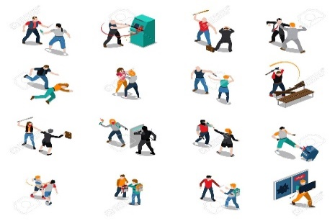

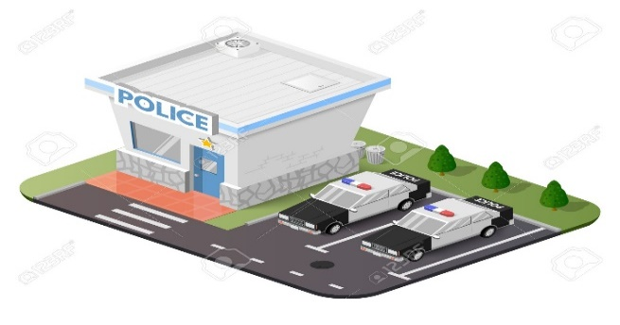

SYSTEM ARCHITECTURE
Crime Data Set
Robbery Data Set acquisition
Video from web camera
Preprocessing
Action Detection
Preprocessing
Action Recognition
Action Detection
Feature Extraction
Action Recognition
Classification
Feature Extraction
Classification
Classified Result
Crime Database Server
Matching
Police Station

Slide 13
METHODOLOGY NoxEye Control Panel
The module integrates the public CCTV Camera(here web camera) to detect the abnormal behaviors.The proposed expert system, hereafter referred to as NoxEye, is capable in detecting suspicious behaviors and provide early warning to the centralized video surveillance system.
Crime Detector Learning Phase
Frames are extracted from video input.
The video must be divided into sequence of images which are further processed.
The speed at which a video must be divided into images depends on the implementation of individuals.

Slide 14
PREPROCESSING
RGB to Grey
Resize()
Denoise() using Gabor Filter
Binarizationn
The YOLO Model predicts the probability of each anchor box being an object or not and generates region proposals by selecting the boxes with high probabilities. RoI Pooling: The region proposals are then passed through a RoI (Region of Interest) pooling layer, which extracts fixed-size feature maps from the convolutional feature maps for each region proposal.
GLCM Feature Extraction used for abnormal activity detection in surveillance videos. Extract features from the video frames using a pre-trained GLCM model.
TCN is a type of CNN that is specifically designed for modeling sequential data.Train a machine learning model on the extracted features to classify normal and abnormal activities.

Slide 15
ALGORITHM
1)CONVOLUTIONAL NEURAL NETWORK
CNNs are a class of deep neural networks specifically designed to process structured grid-like data, such as images. They consist of multiple layers, including convolutional layers, pooling layers, and fully connected layers.
For anomaly and crime detection, CNNs features from images that are crucial for identifying abnormal or suspicious activities. By learning from a large dataset of labeled images, CNNs can automatically detect patterns and anomalies that may not be apparent to the human eye.
Training CNNs for anomaly and crime detection involves feeding them with labeled image data, where anomalies and normal activities are appropriately annotated
CNNs can effectively identify anomalies in images by comparing them to learned representations of normal behavior.

Slide 16
2)YOLOv8
YOLOv8 is a popular object detection model known for its speed and accuracy.It processes an image in a single pass and predicts multiple bounding boxes and class probabilities simultaneously.
Using YOLOv8 for anomaly and crime detection could be highly effective due to its real-time processing capabilities and accurate object detection datasets containing images or videos of various anomalies and criminal activities, such as theft, violence, or vandalism, YOLOv8 can learn to detect these events in real-time video streams or images.Train the YOLOv8 model using the preprocessed dataset. Fine-tuning the model on your specific task and dataset is crucial for achieving optimal performance

Slide 17
FRAMEWORKS & LIBRARIES
TENSOR FLOW - The deep learning model for detecting crime or Suspicious activity
FLASK - Backend of the website
REACT JS - Frontend of the website
YOLOv8 - Detecting weapon using object detection
MySQL - Database
OS - Windows
PROCESSOR - intel i5

Slide 18
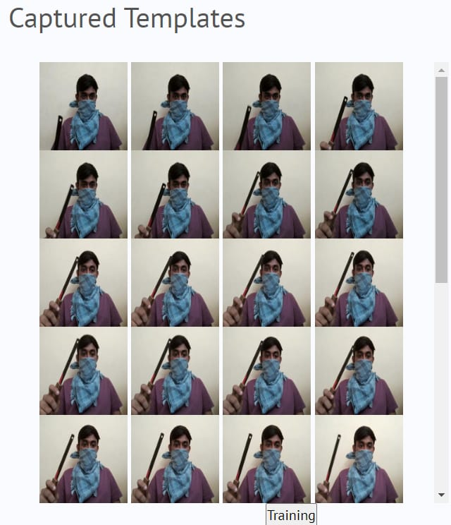
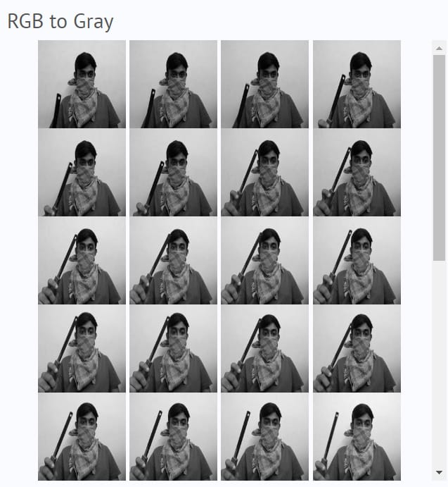
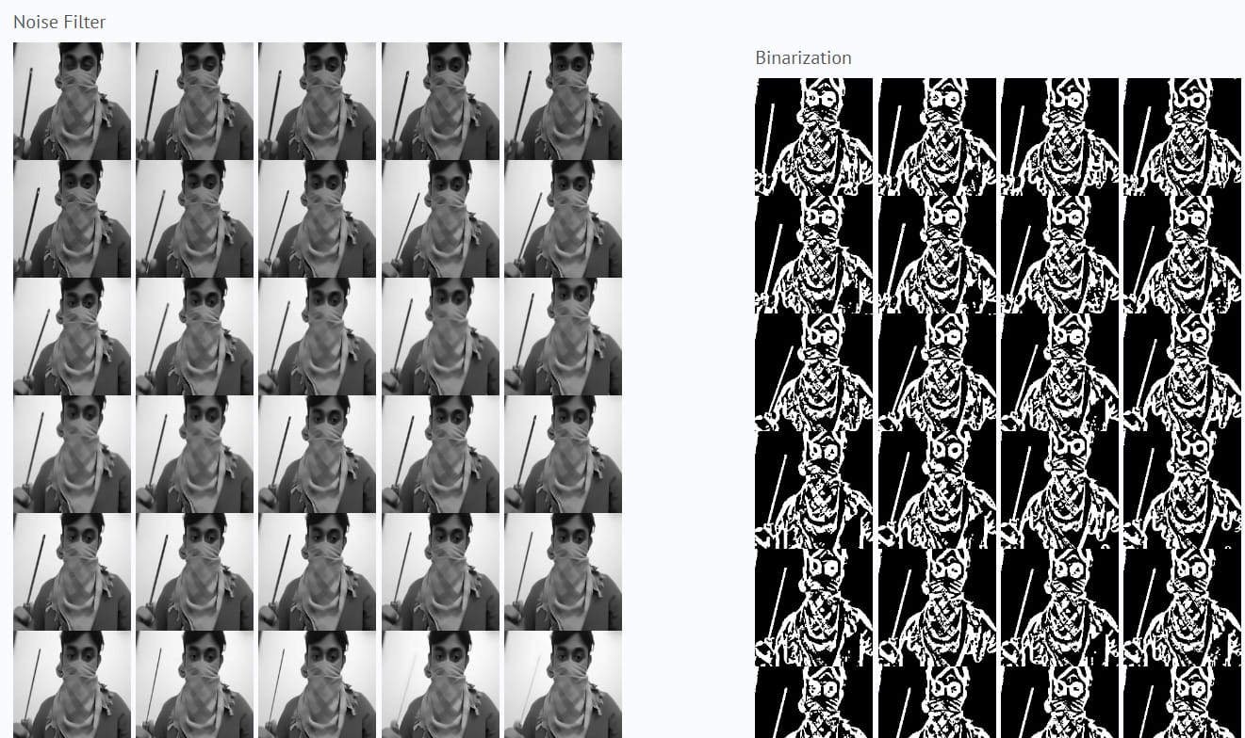
RESULT AND OUTPUT
Captured Templates
RGB to Gray
Noise Filter
Binarization

Slide 19
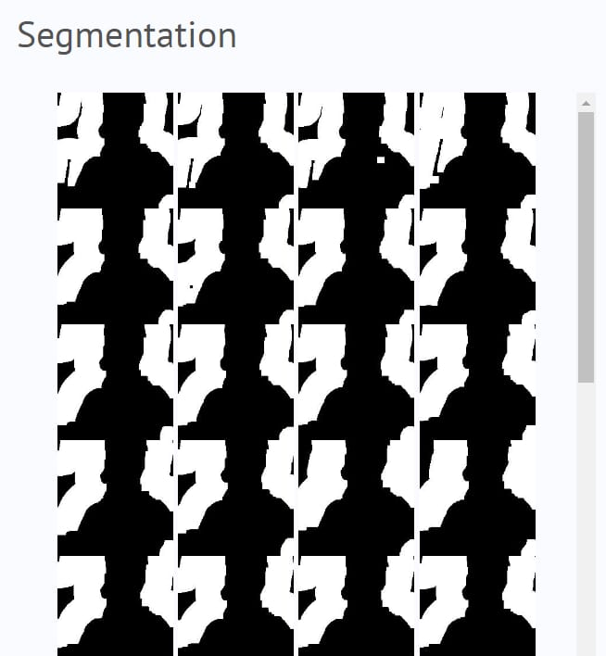
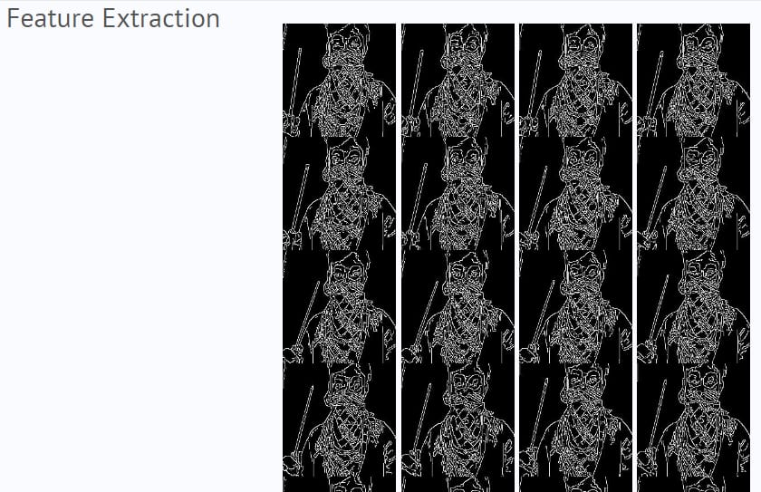

Slide 20
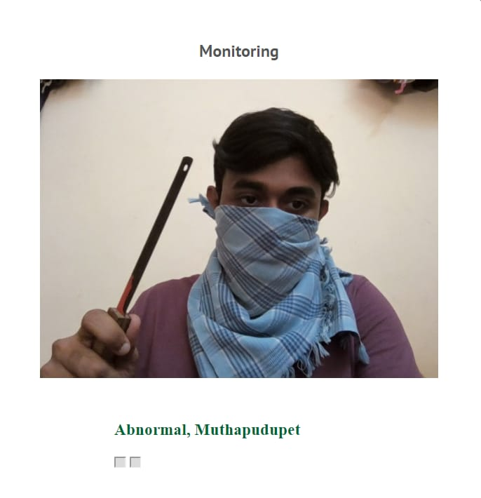
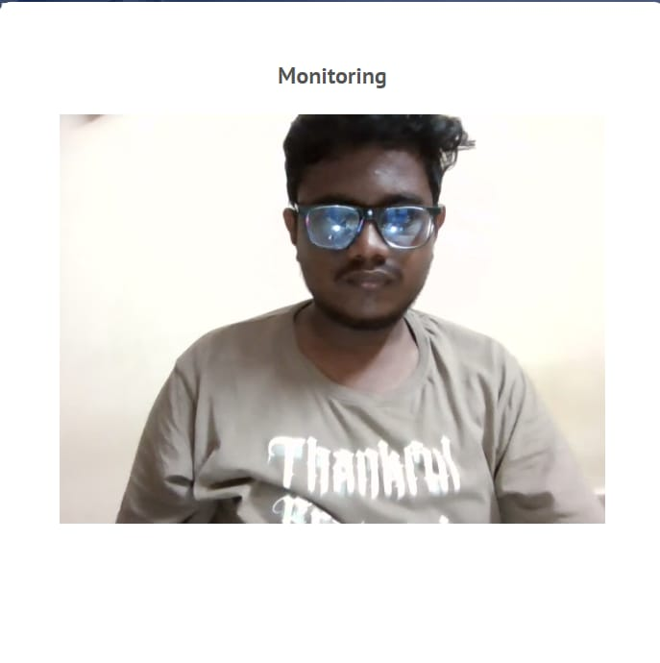
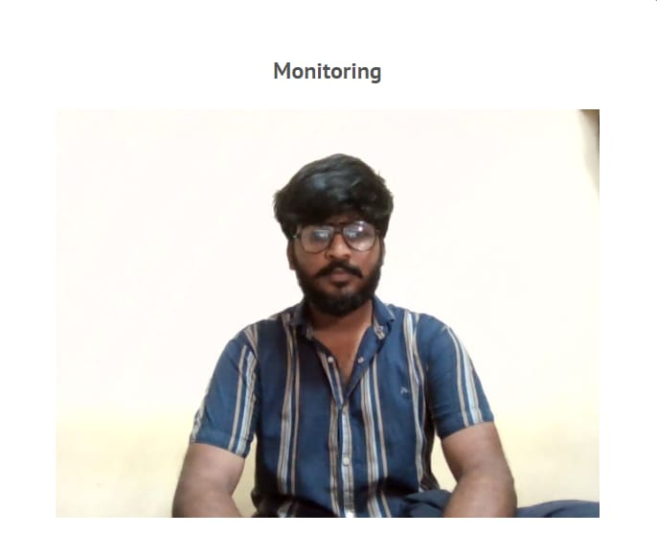
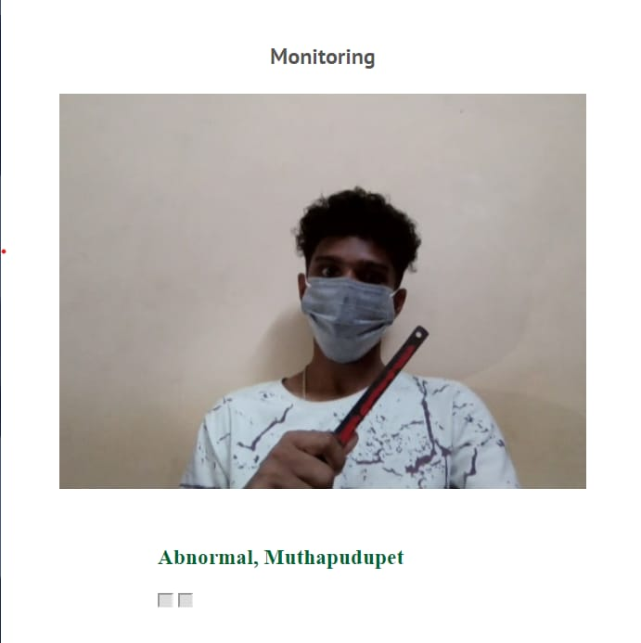

Slide 21
COMPARISON
 | EXISTING SYSTEM | PROPOSED SYSTEM
Accuracy and Classification: | Relies on manual review of CCTV footage, potentially leading to human errors. | Trained on a large dataset of crime footage to classify crimes accurately.
Real-Time Face Recognition: | Does not have this capability, requiring manual identification. | Utilizes real-time face recognition to identify potential suspects
Alert System: | Requires manual monitoring and reporting of incidents. | Generates a message to authorities as soon as a crime is detected.
Database and Storage: | May lack centralized storage, making it challenging to retrieve past incidents. | Stores crime details in a database for future reference.
Privacy and Security: | Potential privacy issues with manual monitoring, especially if footage is not securely managed. | Needs to address privacy concerns related to storing and processing sensitive information.

Slide 22
CONCLUSION
The development of the ADVANCED CCTV ANALYTIC SOLUTION system marks a significant advancement in security technology. Through the integration of cutting-edge AI algorithms, including Convolutional Neural Networks (CNN) and YOLOv8, the system demonstrates a robust capability to detect and respond to abnormal activities in real-time.
The project has successfully achieved its objectives of enhancing security measures through proactive abnormal activity detection, providing timely alerts, and ensuring user-friendly interaction through a unified web-based dashboard.
Through rigorous testing, the system has proven its reliability, accuracy, and scalability, paving the way for its deployment in a variety of critical environments such as public spaces, commercial areas, and government facilities

Slide 23
REFERENCES
1. M.R., M. Makker and A. Ashok, "Anomaly Detection in Surveillance Videos," 2019 26th International Conference on High Performance Computing, Data and Analytics Workshop (HiPCW), Hyderabad, India, 2019
2. Siruruang Phatchuay, and Mahasak Ketcham, “The Surveillance System for Lab Security based on Image Processing”, Int'l Conference on Advanced Computational Technologies & Creative Media Aug. 14-15, 2014 Pattaya (Thailand)
3. Mandar Shriram Munagekar, “Smart Surveillance system for theft detection using image processing”, International Research Journal of Engineering and Technology| Aug 2018
4. Virender Singh, Swati Singh, Pooja Gupta, Real-Time Anomaly Recognition Through CCTV Using Neural Networks, Procedia Computer Science, Volume 173, 2020

Slide 24
5 M. Mandal, L. K. Kumar, M. Singh Saran and S. K. Vipparthi, "MotionRec: A unified deep framework for moving object recognition", Proc. IEEE Winter Conf. Appl. Comput.
6. P. K. Sahoo, P. Kanungo, S. Mishra and B. P. Mohanty, "Entropy feature and peak-means clustering based slowly moving object detection in head and shoulder video sequences", J. King Saud Univ.—Comput. Inf. Sci., vol. 34, no. 8, pp. 5296-5304, Sep. 2022.
7. L. Fan, T. Zhang and W. Du, "Optical-flow-based framework to boost video object detection performance with object enhancement", Expert Syst. Appl., vol. 170, May 2021.
8. Q. Zhang, T. Xiao, N. Huang, D. Zhang and J. Han, "Revisiting feature fusion for RGB-T salient object detection", IEEE Trans. Circuits Syst. Video Technol., vol. 31, no. 5, pp. 1804-1818, May 2021.

Slide 25
9. B. N. Subudhi, M. K. Panda, T. Veerakumar, V. Jakhetiya and S. Esakkirajan, "Kernel-induced possibilistic fuzzy associate background subtraction for video scene", IEEE Trans. Computat. Social Syst., vol. 10, no. 3, pp. 1-12, Jan. 2022.
10. M. K. Panda, B. N. Subudhi, T. Bouwmans, V. Jakheytiya and T. Veerakumar, "An end to end encoder–decoder network with multi-scale feature pulling for detecting local changes from video scene", Proc. 18th IEEE Int. Conf. Adv. Video Signal Based Surveill. (AVSS), pp. 1-8, Nov. 2022.

Slide 26
THANK YOU

